Slide 1
Lecture 12: Market Structures in Value Chain Agriculture

Slide 2
Market Structures
Market structures refer to the organizational characteristics of a market, including the number of sellers and buyers, the level of product differentiation, and the entry barriers.
Four main market structures exist:
Perfect Competition: A market with many small firms selling homogeneous products and facing no barriers to entry or exit.
Oligopoly: A market dominated by a few large firms selling either homogeneous or differentiated products.
Monopolistic Competition: A market with many firms selling differentiated products.
Monopoly: A market with a single seller and no close substitutes.

Slide 3
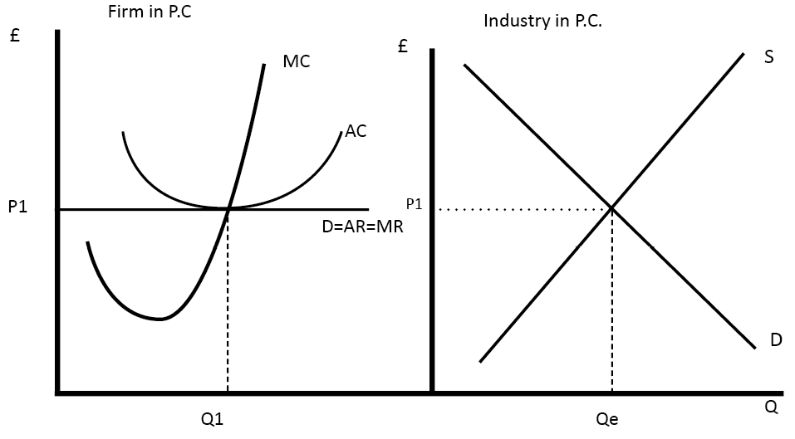
Perfect Competition

Slide 4
Characteristics of Perfect competition
Many small firms
Homogeneous products
No barriers to entry or exit
Price takers (firms accept the market price as given)

Slide 5
Price and Output Determination in Perfect Competition
In perfect competition, firms are price takers, so they cannot influence market price.
The market determines price and output through the interaction of demand and supply.
Individual firms produce at the level where marginal cost equals the market price.

Slide 6
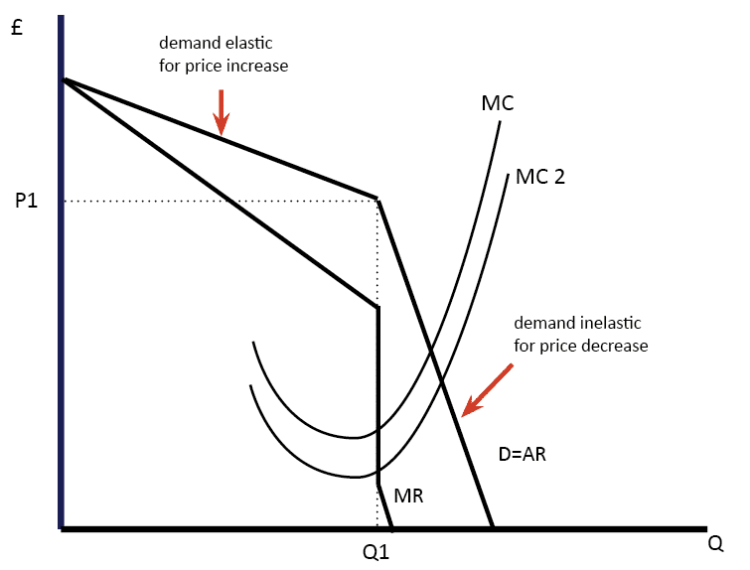
Oligopoly

Slide 7
Characteristics of Oligopoly
Few large firms
Homogeneous or differentiated products
Significant barriers to entry or exit
Mutual interdependence (firms consider rivals' actions)

Slide 8
Price and Output Determination in Oligopoly
In an oligopoly, price and output determination are complex due to interdependence.
Firms may engage in non-price competition (e.g., advertising) and strategic decision-making to gain a competitive advantage.

Slide 9
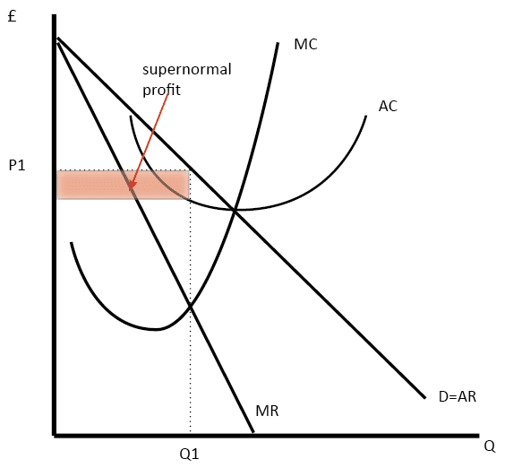
Monopolistic Competition

Slide 10
Characteristics of Monopolistic Competition
Presence of Many firms in the market
Differentiated products
Low barriers to entry or exit
A certain degree of control over product price

Slide 11
Price and Output Determination in Monopolistic Competition
In monopolistic competition, firms have some control over product pricing.
They produce where marginal cost equals marginal revenue but charge a price higher than marginal cost, resulting in excess profits in the short run.

Slide 12
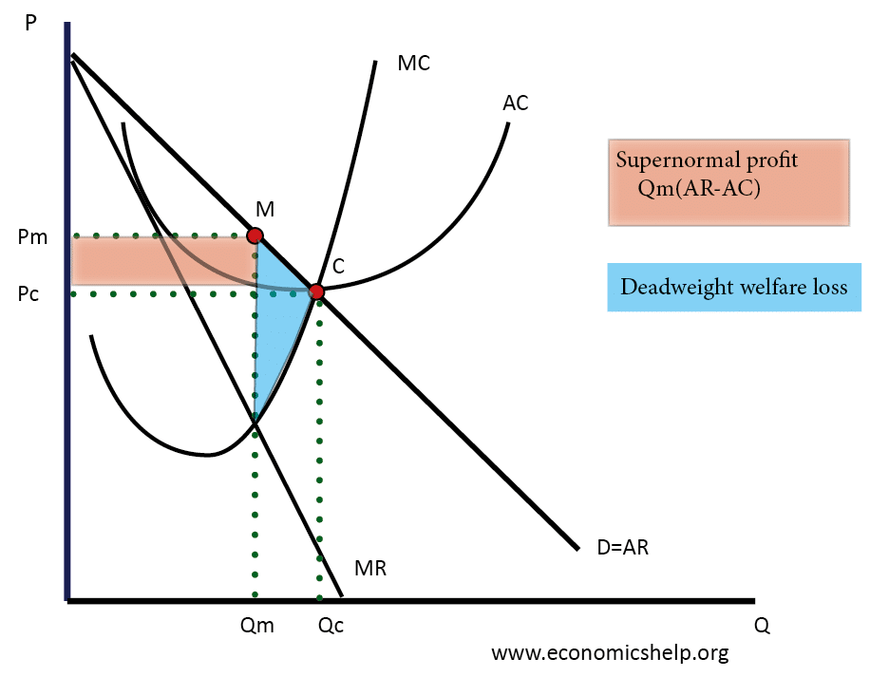
Monopoly

Slide 13
Characteristics of Monopoly
Single seller
No close substitutes
High barriers to entry or exit
Significant market power

Slide 14
Price and Output Determination in Monopoly
In a monopoly, the firm is a price maker, having the power to set the price.
The firm maximizes profits by equating marginal cost to marginal revenue, and the price charged is higher than marginal cost.

Slide 15
Efficiency and Performance Implications of Market Structures
Perfect Competition:
Allocative efficiency: Price is equal to marginal cost(P=MC)
Productive efficiency: Firms produce at the minimum average cost(Lowest point on the AC curve)
Oligopoly and Monopolistic Competition:
Less allocative and productive efficiency compared to perfect competition.
Monopoly:
Lower output and higher price compared to perfect competition.
Lower overall welfare due to deadweight loss.

Slide 16
Welfare Economics
Welfare economics is a branch of economics that focuses on the study of how the allocation of resources and the distribution of goods and services affect the well-being and welfare of individuals and society as a whole.
It aims at analyzing and evaluating the efficiency and equity of economic outcomes and guide policymakers in designing effective and socially beneficial policies.

Slide 17
Welfare Economics
Welfare economics plays a significant role in value chain agriculture by focusing on optimizing resource allocation, improving efficiency, and promoting equitable distribution of benefits throughout the agricultural supply chain.
This branch of economics evaluates the impact of value chain activities on the well-being of stakeholders, including farmers, consumers, and the broader community.

Slide 18
Efficiency and Equity in Value Chain Agriculture:
Efficiency
Efficiency refers to maximizing output with minimal input, achieving higher productivity, reducing waste, and improving resource allocation.
Welfare economics guides stakeholders to identify opportunities for efficiency gains and implement best practices throughout the value chain.
Equity
Equity entails ensuring fair distribution of benefits among different actors e.g. smallholder farmers, laborers, and processors.
Welfare economics assesses income distribution and recommends policies to address disparities and create a more inclusive and equitable value chain.

Slide 19
Externalities and Market Failures:
Value chain agriculture may generate positive or negative externalities that affect the broader society.
Positive externalities, such as sustainable farming practices that improve soil health, benefit the community.
Conversely, negative externalities, like environmental pollution from chemical usage, can harm the environment and public health.
Welfare economics identifies externalities and suggests interventions to internalize them in value chain decisions.

Slide 20
Policy Interventions for Social Welfare Maximization:
Welfare economics provides valuable insights into the impact of policy interventions on the well-being of stakeholders.
Policymakers can use cost-benefit analysis to evaluate different agricultural policies, such as subsidies, price controls, and trade regulations, to ensure that they maximize overall social welfare while considering efficiency and equity objectives.

Slide 21
Sustainable Value Chain Management:
Value chain agriculture is closely linked to sustainability and responsible resource management.
Welfare economics helps value chain actors identify practices that promote sustainable agriculture, reduce environmental degradation, and foster long-term economic viability while supporting the welfare of communities.

Slide 22
Examples of Welfare Economics in Value Chain Agriculture
Fair Trade Certification:
Fair trade certification ensures that farmers receive a fair price for their produce, promoting equitable income distribution and social welfare improvement for smallholder farmers
Environmental Conservation Programs:
Programs that incentivize sustainable agricultural practices, such as organic farming or water conservation, aim to balance economic growth with environmental protection, leading to positive externalities for the community.
Market Access Initiatives:
Policies that improve market access for small-scale farmers, such as building infrastructure or providing market information, can enhance efficiency and increase the welfare of rural communities.

Slide 23
Welfare economics is a valuable tool for value chain agriculture students and stakeholders as it fosters a deeper understanding of the interplay between economic decisions, social well-being, and sustainability.
By applying welfare economics principles, value chain agriculture can achieve better resource allocation, inclusive growth, and environmentally sustainable practices, ultimately contributing to the overall welfare and prosperity of communities and society as a whole.

Slide 24
Case Studies and Exercises

Slide 25
Exercise 1: Perfect Competition:
Suppose there are ten firms in a perfectly competitive market, each producing identical widgets. The market demand for widgets is given by Qd = 1000 - 10P, where Qd is the quantity demanded and P is the price. The firms' cost function is given by TC = 50Q, where TC is the total cost and Q is the quantity produced by each firm.
Determine the market price and quantity supplied by each firm in the long run.

Slide 26
Exercise 2: Oligopoly
Consider an oligopoly market with three major firms producing smartphones. The market demand for smartphones is given by Qd = 2000 - 5P, where Qd is the quantity demanded and P is the price. Each firm's cost function is given by TC = 200Q, where TC is the total cost and Q is the quantity produced by each firm.
Determine the Nash equilibrium price and quantity produced by each firm.

Slide 27
Exercise 3: Monopolistic Competition
In a monopolistic competition market, there are six firms producing similar but differentiated products. The market demand for the products is given by Qd = 800 - 2P, where Qd is the quantity demanded and P is the price. Each firm's cost function is given by TC = 100Q, where TC is the total cost and Q is the quantity produced by each firm.
Calculate the price, output, and profit for each firm in the short run.

Slide 28
Exercise 4: Monopoly
Suppose a monopolist faces the market demand Qd = 500 - P, where Qd is the quantity demanded and P is the price. The monopolist's cost function is given by TC = 100Q, where TC is the total cost and Q is the quantity produced.
Determine the profit-maximizing price and quantity produced by the monopolist.

Slide 29
Case Studies:
1. Perfect Competition: Agricultural Commodities Market
In a hypothetical perfect competition market for maize in Malawi, there are numerous small farmers producing and selling maize. Each farmer sells their harvest at the prevailing market price. Analyze how market forces of demand and supply determine the price and quantity of maize sold in the market.
2. Oligopoly: Pesticide Market
The pesticide market in Malawi is dominated by three major firms. Each firm produces a different type of pesticide. Analyze how these firms' pricing decisions and product differentiation strategies impact the market's overall performance and competition.
3. Monopolistic Competition: Fertilizer Market
The fertilizer market in Malawi consists of six firms producing different types of fertilizers. Each firm engages in advertising and branding to differentiate their products. Analyze the implications of product differentiation and the firms' pricing decisions on consumer choices and market outcomes.
4. Monopoly: Seed Market
A single firm holds a monopoly in the seed market in Malawi. Analyze the monopolist's ability to set the price and its impact on consumer welfare and market efficiency. Consider potential regulatory interventions to promote competition and consumer welfare.

